Slide 1
AWS Guard Duty Azure Security Center
AWS Guard Duty & Azure Security Center
Orhen Hasday
Jul-21

Slide 2
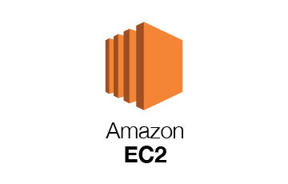
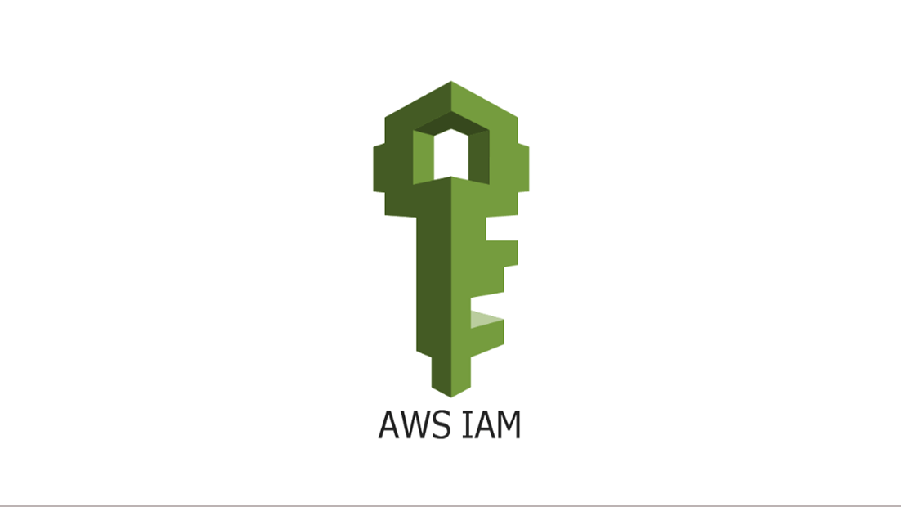
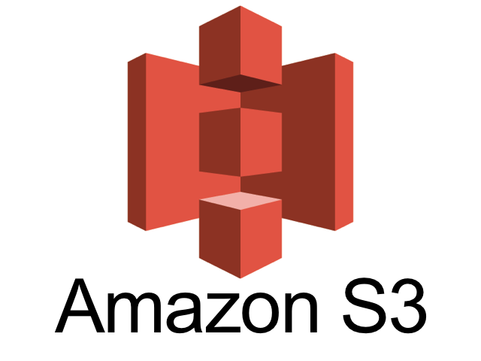
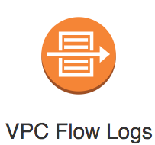
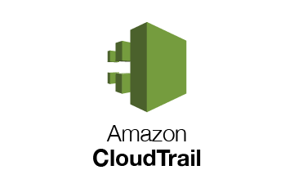

AWS Guard Duty
AWS DNS logs
https://docs.aws.amazon.com/guardduty/latest/ug/guardduty_data-sources.html

Slide 3
AWS Guard Duty AWS Security Hub Azure Defender Azure Security Center

Slide 4
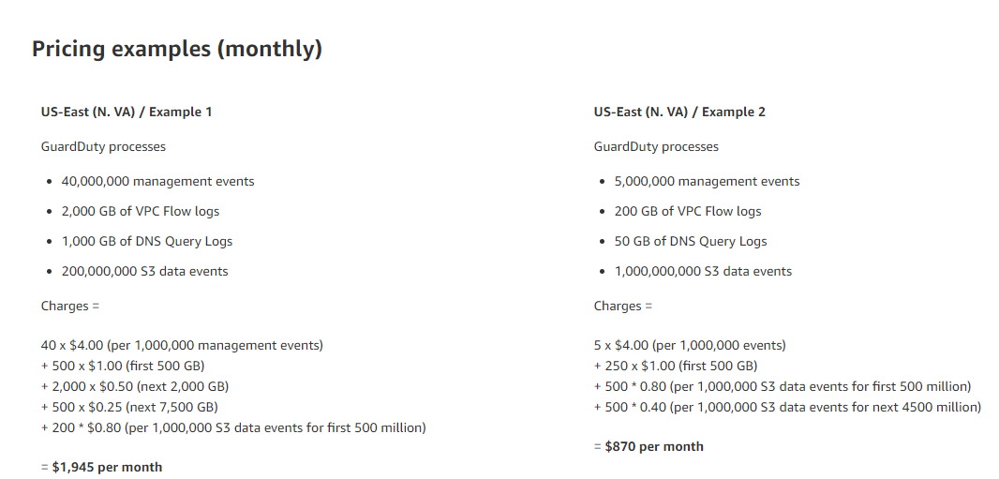
AWS Guard Duty (cost)
Price in each region would be different.

Slide 5
AWS Security Hub (cost)
2 pricing dimensions for Security Hub:
Number of security checks per account/region/month
First 100,000 Checks | $0.001
Next 400,000 Checks | $0.0008
Above 500,000 Checks | $0.0005
Number of finding ingestion events per account/region/month
Perpetual Tier of 10000 | Free
After the first 10,000 | $0.00003
Customers are not charged for finding ingestion events generated by Security Hub’s security checks

Slide 6
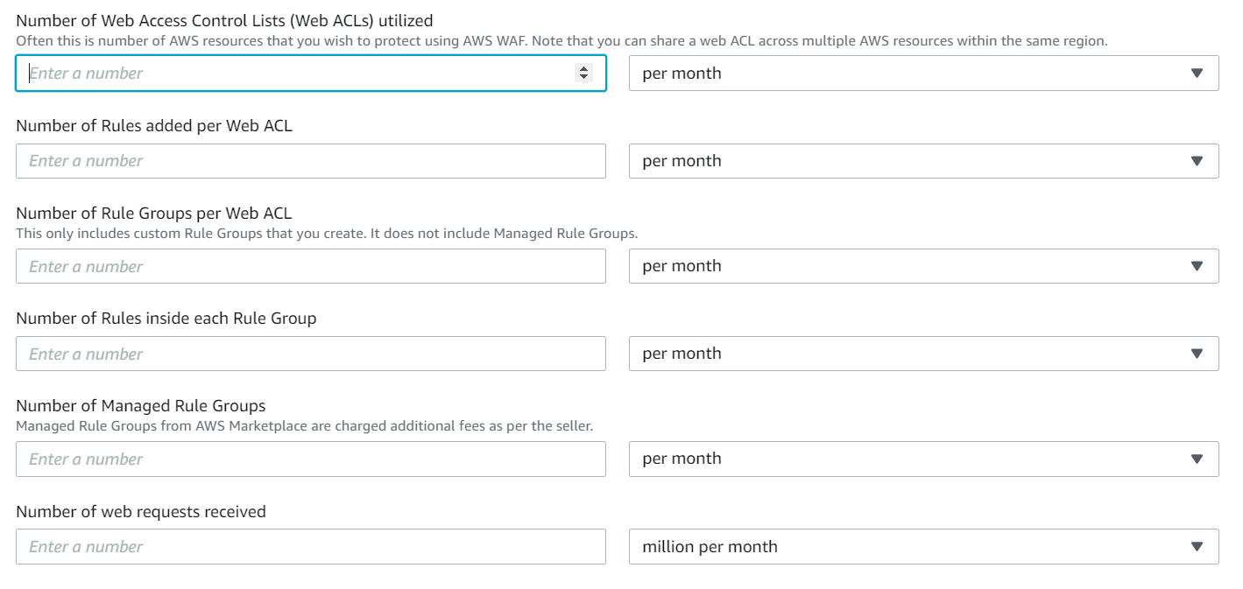
AWS WAF (cost)
Pricing - AWS WAF - Amazon Web Services (AWS)

Slide 7
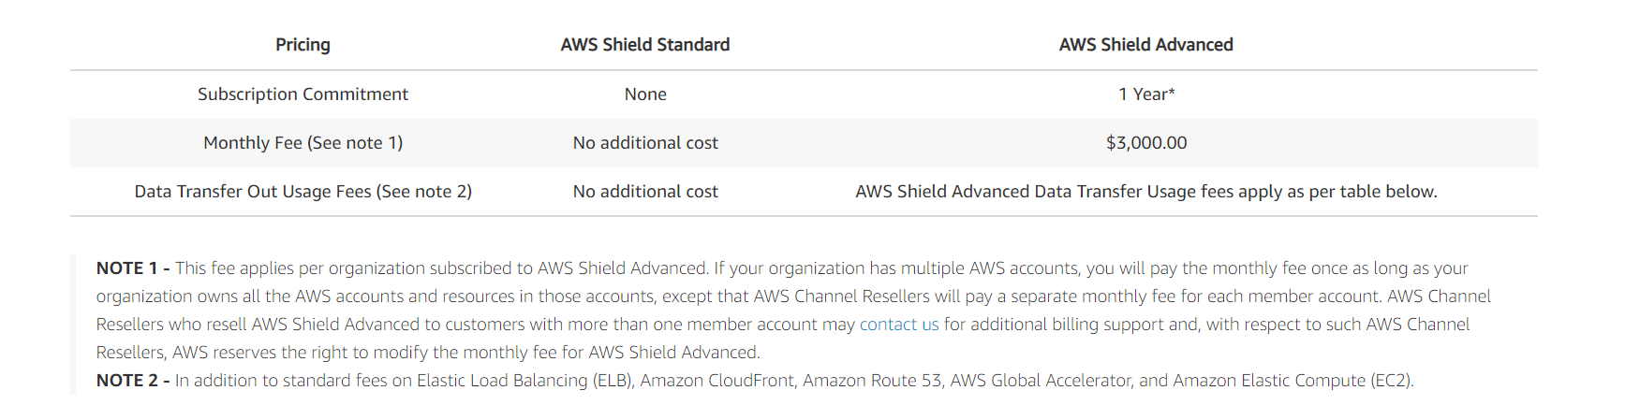
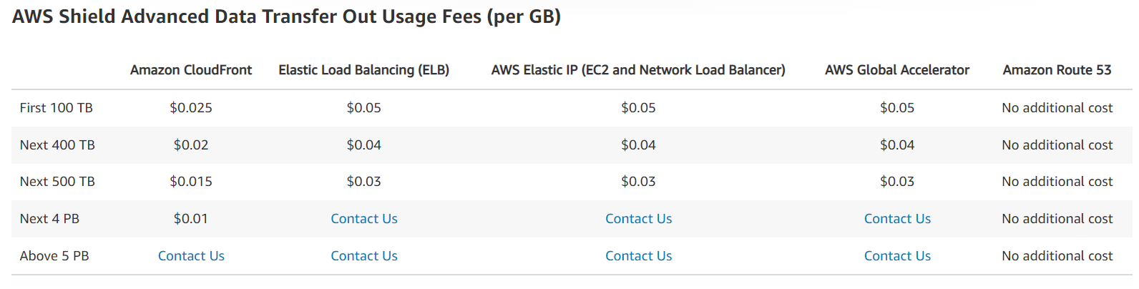
AWS Shield (cost)

Slide 8
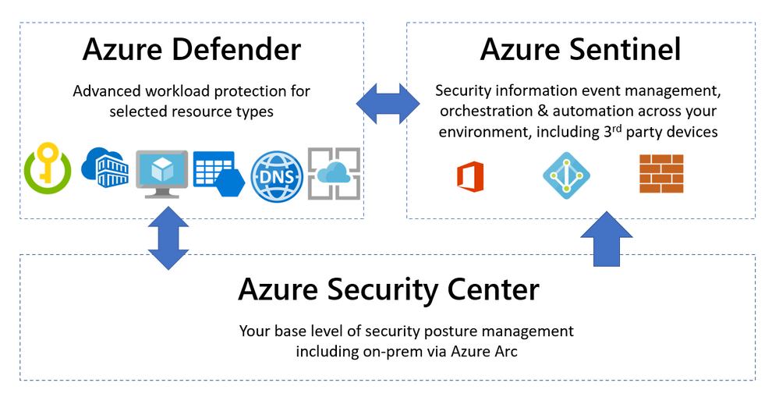
Azure Security Center
https://query.prod.cms.rt.microsoft.com/cms/api/am/binary/RE4s2L2
Azure Security Center provides unified security management and advanced threat protection across hybrid cloud workloads (both azure based, inhouse resources).

Slide 9
Azure Defender
Azure Defender. Is configured to add additional security alerts and advanced threat detection for certain types of resources.
Available for servers, app service, Storage, SQL, Key Vault, Resource Manager, DNS, Kubernetes and container registries

Slide 10
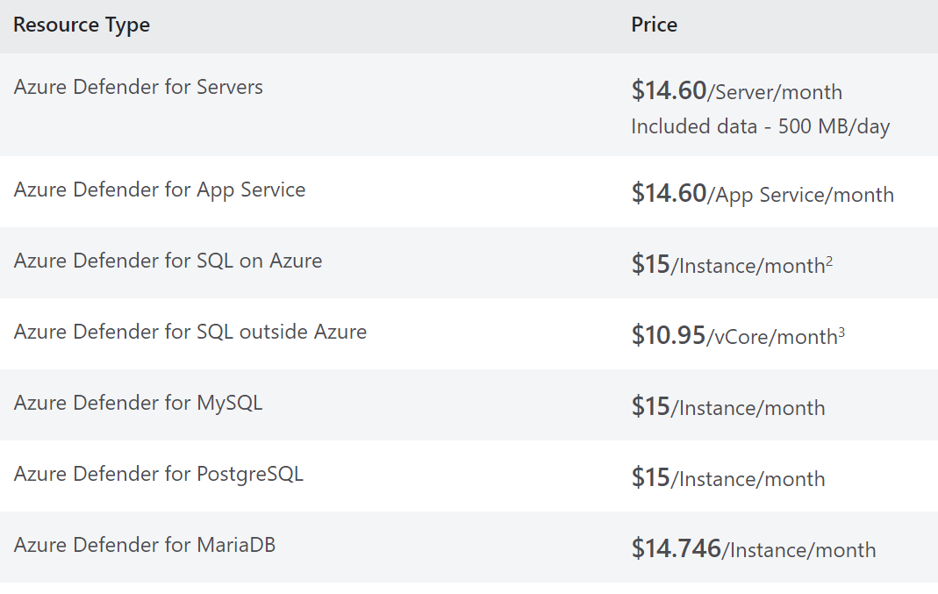
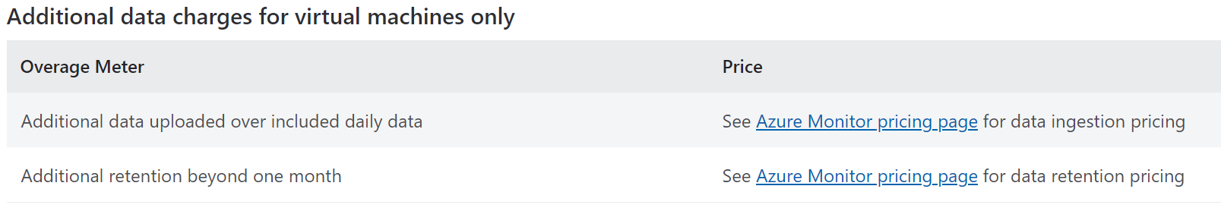
Azure Security Center (cost)
Azure Security Center has 2 offerings:
Azure Security Center free
Azure Defender
If you enable Azure Defender for subscription, all resources would be part of Pricing.
To enable it certain resources in a resource type enable it through workspace
Pricing across regions are almost similar with very small variation.
Pricing is bases on Resource type:
Pricing—Azure Defender | Microsoft Azure

Slide 11
Azure WAF
Azure Web Application Firewall protects your web applications from bot attacks and common web vulnerabilities such as SQL injection and cross-site scripting.
WAF can be deployed with Azure Application Gateway, Azure Front Door, and Azure Content Delivery Network (CDN) service

Slide 12
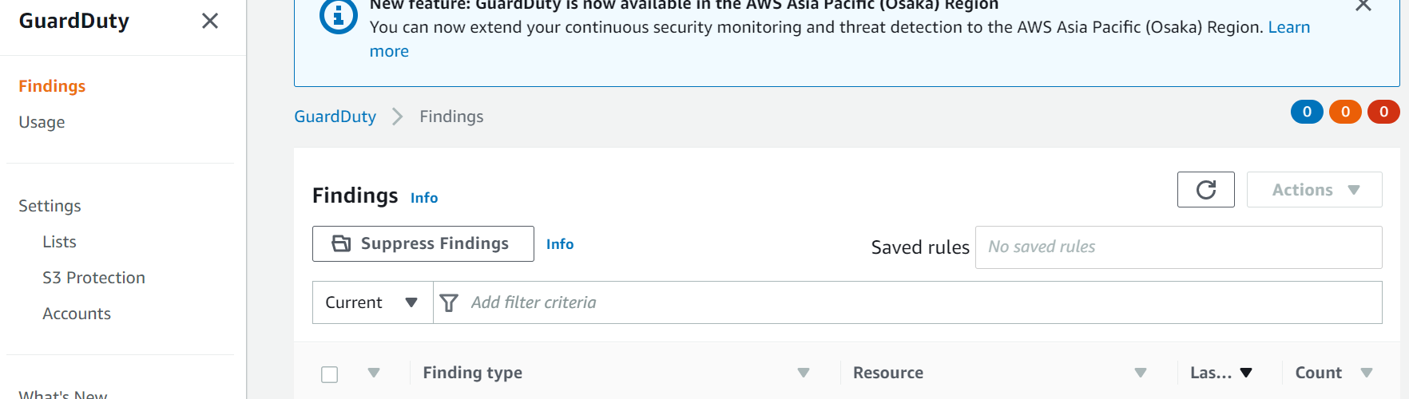
Configuration- AWS GuardDuty

Slide 13
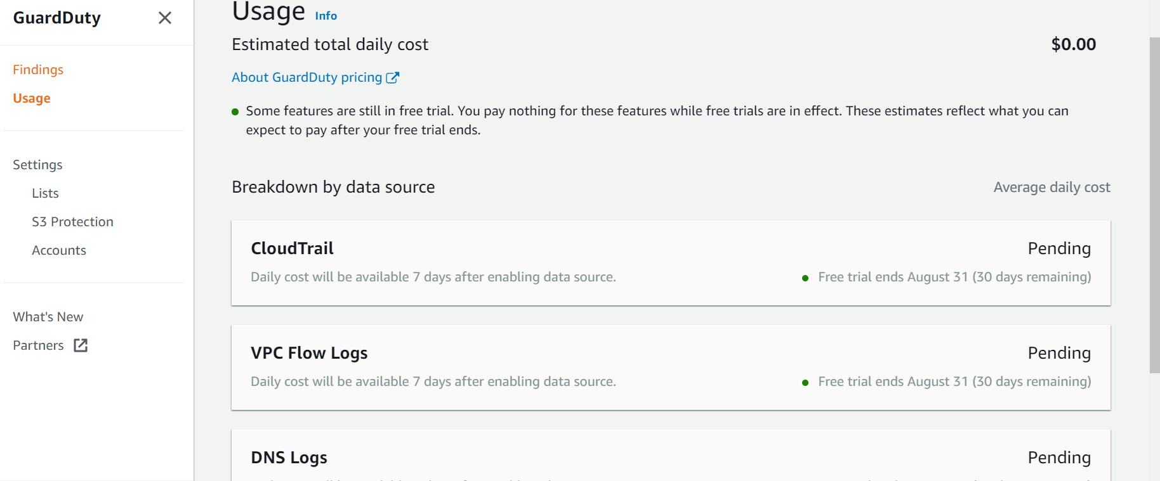
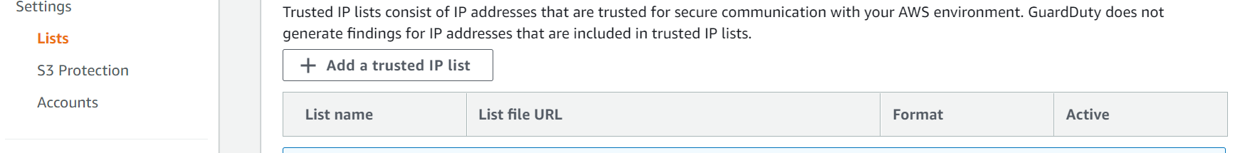
Configuration- AWS GuardDuty

Slide 14
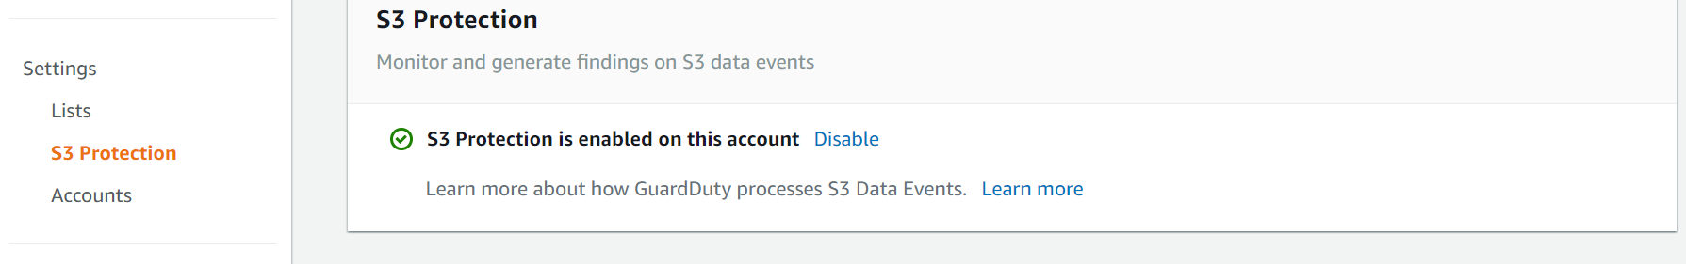
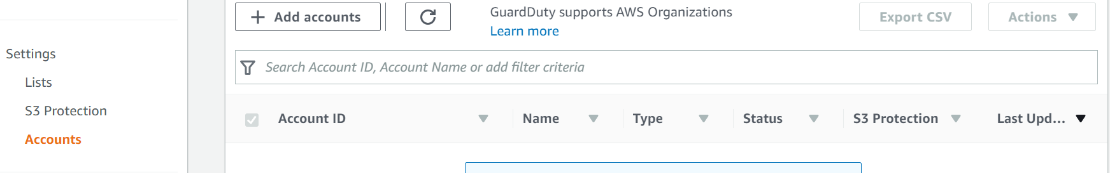
Configuration- AWS GuardDuty

Slide 15
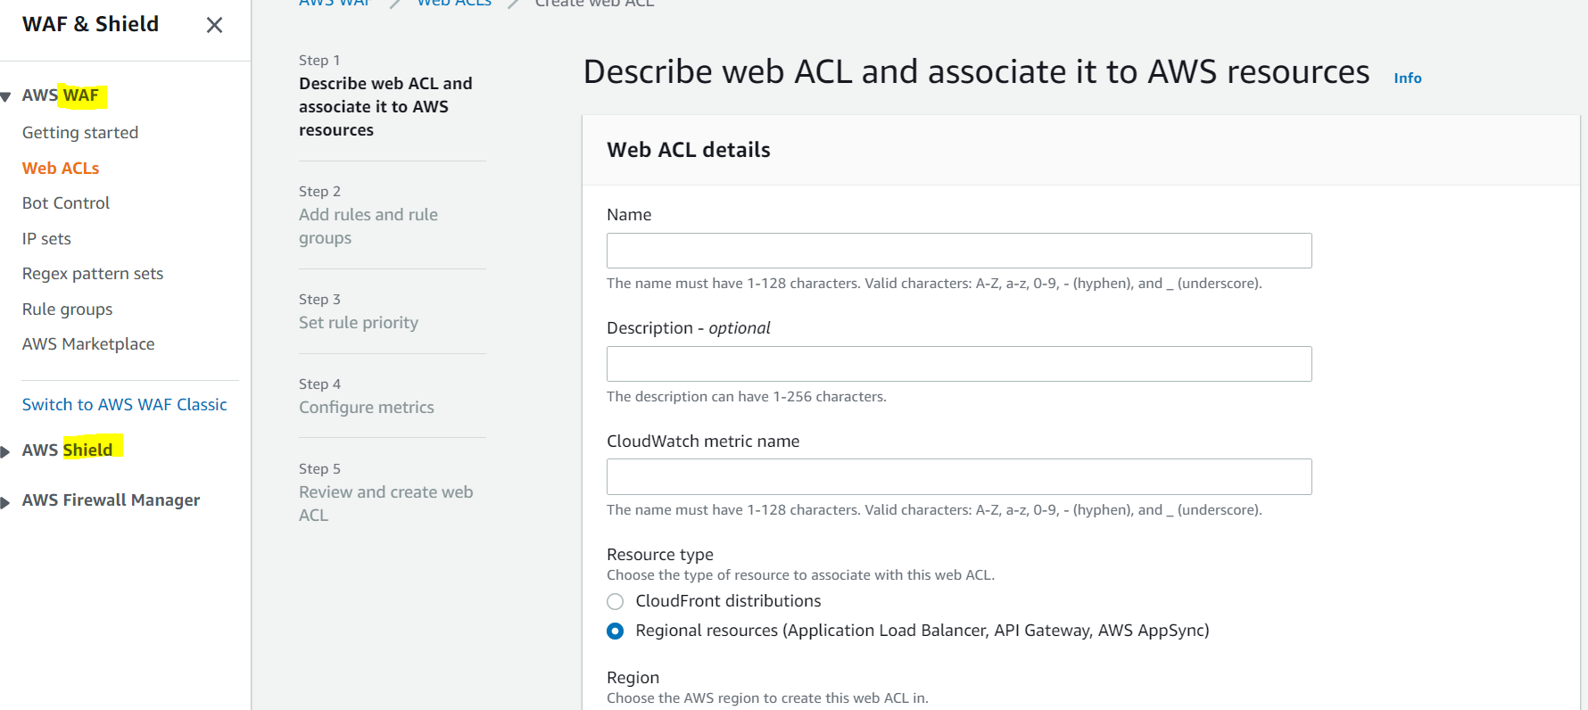
Configuration- AWS WAF

Slide 16
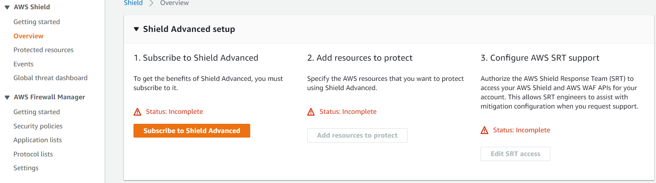
Configuration- AWS Shield

Slide 17
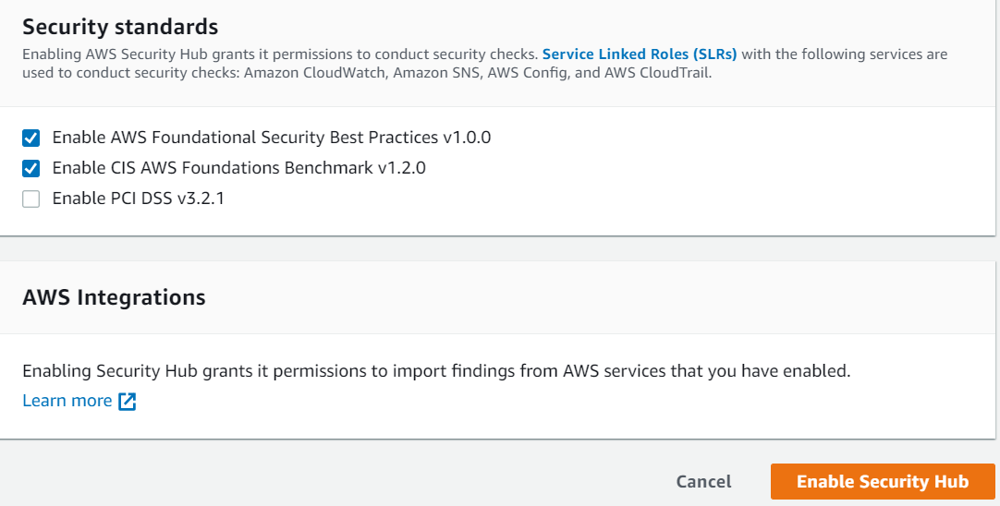
Configuration- AWS Security Hub

Slide 18
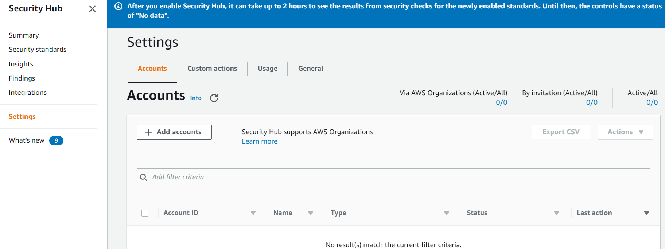
Configuration- AWS Security Hub

Slide 19
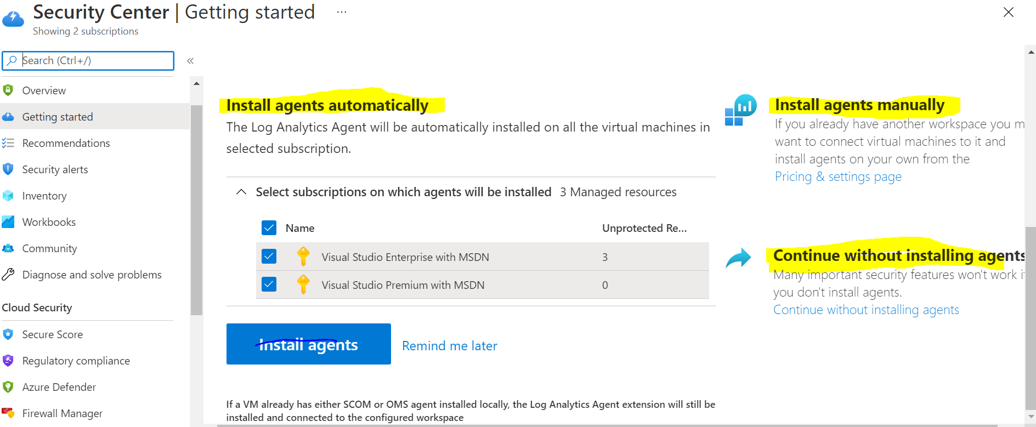
Configuration- Azure Security Centre

Slide 20
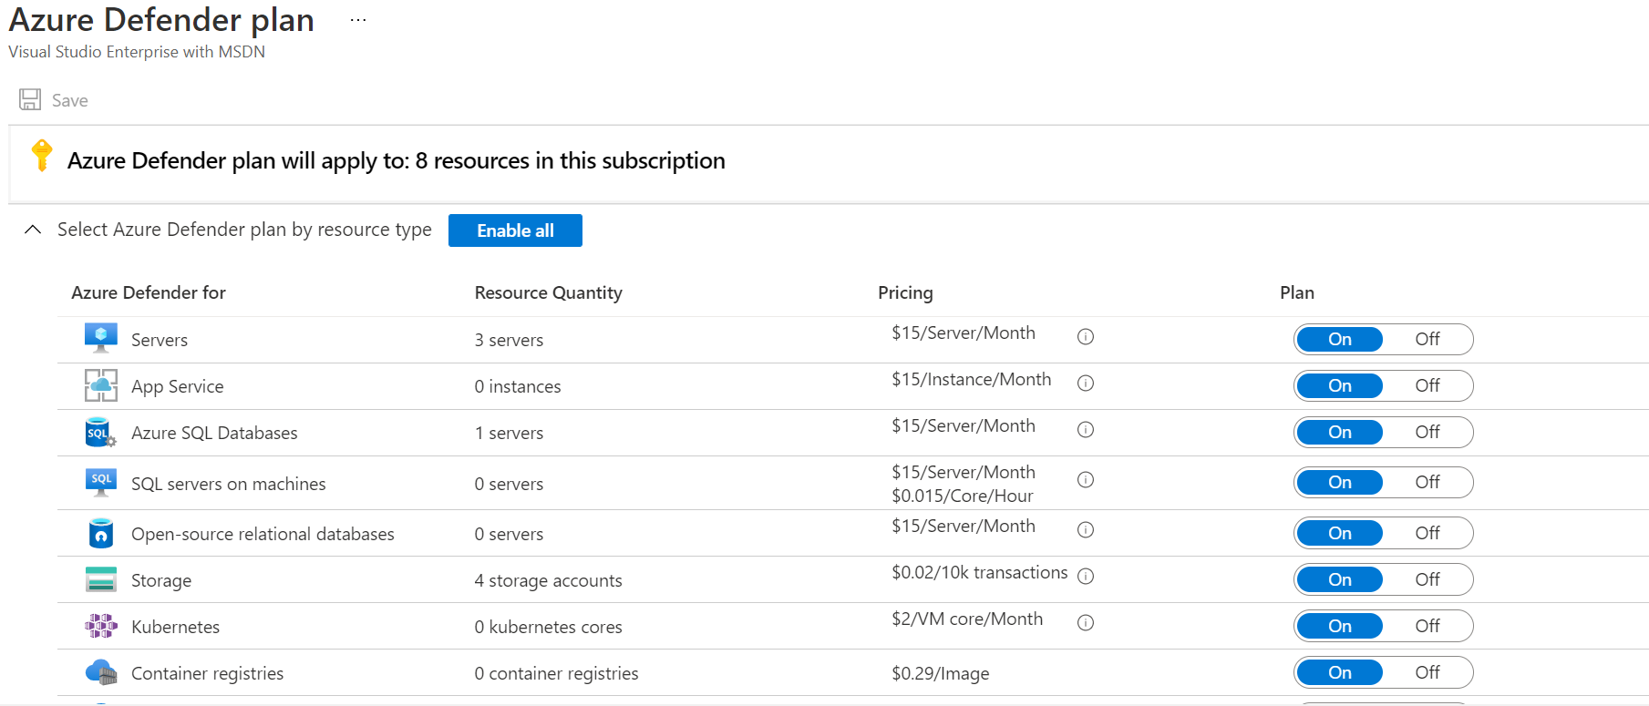
Configuration- Azure Security Centre

